Slide 1
DHEC’s Role in Drinking Water Protection

Slide 2
Tonight’s Meeting
Share information on DHEC’s role with public water systems
Introduce partnering organizations
Hear your experience and perspectives
Define a path forward
Notes:
Ground rules—maybe by flip chart

Slide 3
DHEC’s Role
Vision – Healthy people living in healthy communities
Mission – To improve the quality of life for all South Carolinians by protecting and promoting the health of the public and the environment

Slide 4
Your Regional Office
Orangeburg Office
1550 Carolina Ave.
Aiken Office
206 Beaufort Street, NE

Slide 5
DHEC’s Role in Drinking Water Protection
Enforces federal & state laws and regulations
Ensures compliance monitoring is conducted and reviews sample results of public water systems
Conducts annual inspections of community public water systems
Responds to complaints within 24 hours of receiving them

Slide 6
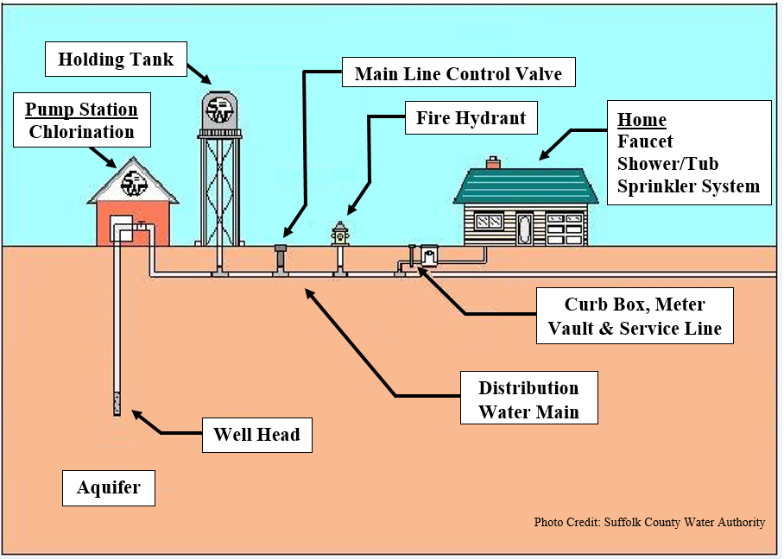

Slide 7
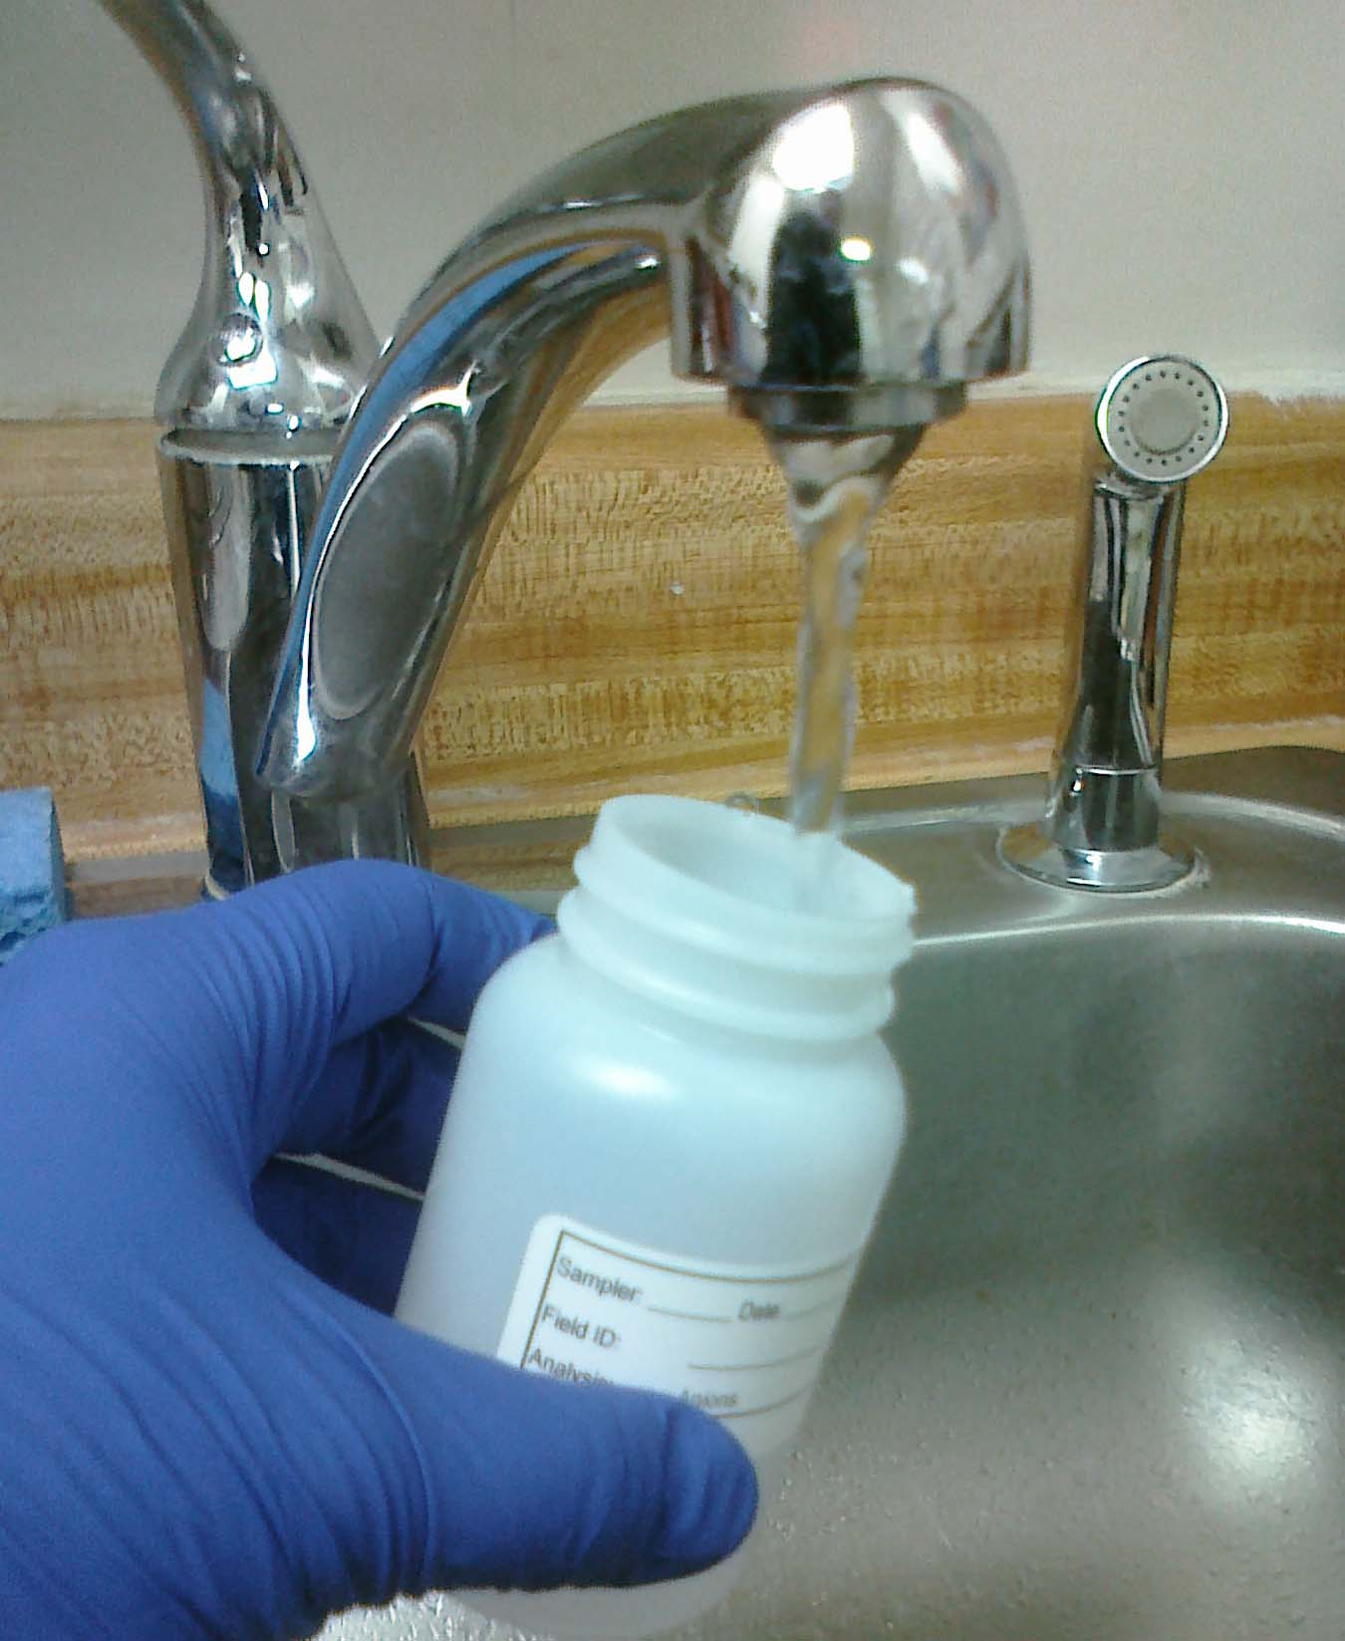
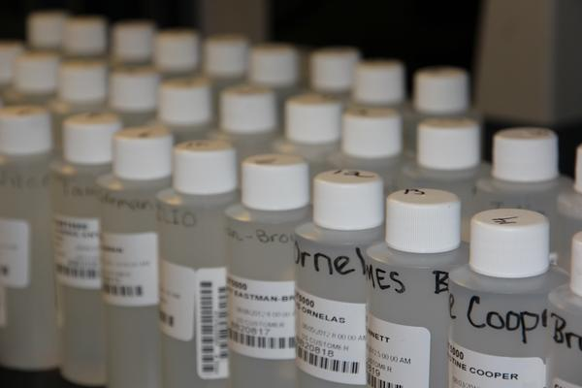
Different Types of Sampling
Notes:
Us or lab or homeowner collect by different rules—hit bacteria first, certified labs, certified testers, which company where results go. #2 Pb and Cu process only part done by homeowner, #3 Other, based on need basis DHEC has capability to do all of these on next slide, different timelines by the rules. Add photo of how sample taken. Procedures and documentation needed to generate data for regulatory decision making.

Slide 8
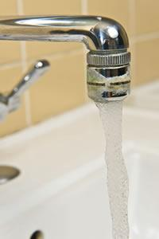
Drinking Water and Public Health
DHEC monitors public water systems for:
EPA-regulated chemicals known to have adverse health effects
Currently the City of Denmark is in compliance with all health based drinking water standards
Notes:
DHEC staff collects drinking water samples and send them to a certified laboratory for analysis
Check dates and messaging

Slide 9
Secondary Contaminants
EPA has set standards for additional chemicals that affect odor, taste & appearance
Two of these are Iron & Manganese
Secondary standards are set to give public water systems guidance but are not enforceable
Notes:
Irritants . Fe Mn add photos Odor taste and appearance. Not health based standards. Regulated by epa based on nuisance.

Slide 10
History of City of Denmark Drinking Water
In 2010
As a result of numerous complaints & our annual inspection, DHEC found operations & maintenance issues
DHEC issued Consent Order requiring corrective action to address concerns identified
The City of Denmark met all of the conditions of the Consent Order and it was closed in 2013
Recent Sanitary Survey results
Notes:
SS caught it before it was a problem. Found an issue and being addressed

Slide 12
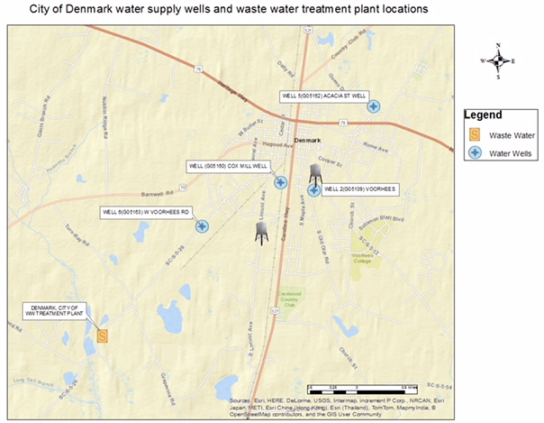

Slide 13
Well | Well Type | Pump (HP) | Yield (GPM) | Depth (ft) | Treatment
Voorhees Well | Turbine | 60 | 330 | 305 | Gaseous Chlorine
Cox Mill Well | Turbine | 50 | 350 | 302 | Gaseous Chlorine HaloSan tablets
Acacia Street Well | Submersible | 40 | 403 | 290 | Gaseous Chlorine
W. Voorhees Well | Submersible | 40 | 325 | 310 | Gaseous Chlorine
Notes:
Change regulated capacity to depth

Slide 14
Voorhees Well

Slide 15
Cox Mill Well

Slide 16
Acacia Street Well

Slide 17
W. Voorhees Well

Slide 18
Working together for you
DHEC
State Drinking Water Technical Advisory Council
SC Rural Water Association
SC Section of the American Waterworks Association
Academic partners
Local Resources
Edisto Riverkeeper
Members of the community
Notes:
Logos We are responsive to the concerns of the citiz3ens of SC. Have partners identified.
Not excluding anyone at the table. We appreciate value and respect what academia provides.
That conversation is continuing
Improving water quality in small systems across the state is part of our strategy especially with again infrastructure. Not only unique to SC but across the country.

Slide 19
Where do we go from here?
What DHEC will do
Collect information and data
Share information
Assess the information
Identify additional needs for water quality improvements
What you can do
Continue to connect with DHEC
Report all concerns
Attend community meetings
Stay informed
Notes:
Monitoring for something doesn’t make it go away

Slide 20
Jennifer Hughes
Assistant Bureau Chief
Bureau of Water
(803) 898-1992
hughesjr@dhec.sc.gov
Orangeburg Regional Office
Travis Fuss
Area Director
Bureau of Environmental Health Services
(803) 533-5490
(803) 642-1637
fusstr@dhec.sc.gov

